Slide 1

1. It can be predicted that before long many people will be using drones to deliver daily supplies like food and drink.
predict vt. 预言; 预测; 预告
Nobody could predict the outcome.
It is predicted that _____________________________________
(失业率会继续下降) in the following year.
sth is predicted to do sth
Unemployment rate was predicted to continue to fall in the following year.
forecast/project
unemployment rate would continue to fall

Slide 2
prediction n. 预言, 预测
predictable adj. 可预见的, 可预料的
predictive adj. 预测的，预言性的
forecast/projection
the predictive power of science
1) 要预测出谁将获胜是不可能的。
It’s impossible to ____________________.
2) 明天早上，飓风将到达海岸。
The hurricane ___________________ the coast tomorrow morning.
3) 我们都认为这本书的结局是完全可以预料的。
We all think that the ending of the book __________________
___________.
predict who will win
is predicted to reach
is completely predictable
Notes:
make a prediction about

Slide 3
2. This could not only save time, but also greatly decrease road traffic.
(1) decrease to… 减少到……
decrease by… 减少了……
decrease (v.) in…= a decrease (n.) in… 在……方面减少
(2) on the decrease 正在减少
on the increase 正在增加

Slide 4
【语境应用】单句语法填空/补全句子。
1) ____________ (decrease) the amount of rubbish and to protect the environment, more governments are requiring people to recycle materials.
2) The number of people aged 50 and under will ___________ ______________ (减少了超过30%) during the time.
3) As far as I know, the members of the association _________
_________________________ (减少到300) .
To decrease
decrease by more than 30%
have decreased to three hundred

Slide 5
1. Many important figures in the music world started making __________ (predict) about Beethoven’s extraordinary future.
2. Every recommendation she gives me is great since she can predict _______ I will like a particular restaurant.
3. Taking targeted measures to help people lift themselves out of poverty, ______ predicted, is fruitful.
4. Technology___________(predict) to play an even more important role in our lives in the future.
5. For many years, people have dreamed of electric cars. However, making them has been more difficult than ________ (predict).
6. Senior citizens long for a more ___________ (predict) and secure future.
predictions
whether
as
is predicted
predicted
predictable

Slide 6
3. There can be (is) no denying that the technology will have a huge impact on everyday life. 无可否认的是……
There's no denying that quicker action could have saved them.
It can't be denied that we need to devote more resources to this problem.
deny vt. 1) 否认，否定 say sth is not true
deny (doing) sth /deny that ... 否认做……
deny all knowledge of sth 彻底否认知道某事
The spokesman refused either to confirm or deny the reports.
The department denies responsibility for what occurred.
拒绝为……承担责任
Notes:
这个部门拒绝为所发生的事承担责任。
turn sb down

Slide 7
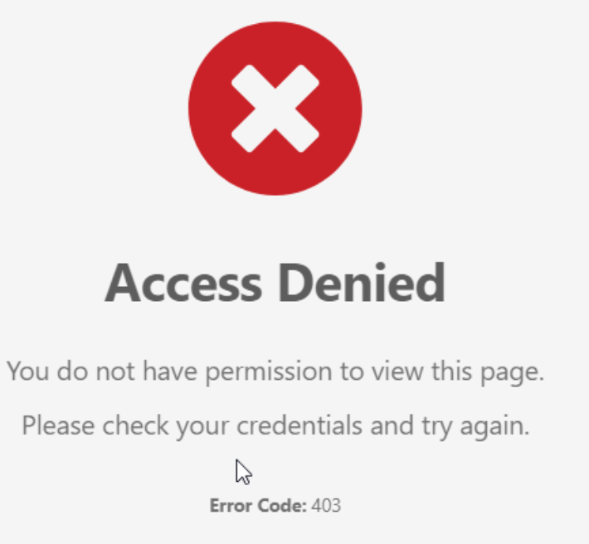
2) 拒绝给予 refuse to allow sb to have sth 剥夺(应有的权利)
deny sb sth/deny sth to sb
Some doting parents never denied their children anything.
统一校服可能会压制学生的个性并剥夺学生选择的自由。
School uniforms may repress individuality and
________________________________.
They were denied access to the school library.
denial n. 否认；拒绝给予
I got hurt by his denial of my advice.
deny students the freedom of choice
Notes:
If someone denies you something, they do not allow you to have it. I never denied her anything.

Slide 8
【语境应用】完成句子。
1) No one should be denied a good education.
(翻译)
A good education should ____ ______ _____ _____ _____.
2) _____________________ (无可否认) we need to devote more resources to this problem.
3) The boy denied that he had broken the window.
The boy ______ _____ _____ ________.
4) 两家公司都否认对这场悲剧负有任何责任。
Both firms deny any responsibility for the tragedy.
任何人都不应被剥夺良好的教育。
be denied to no one
It can’t be denied that
/There’s no denying that
denied breaking the window

Slide 9
4. When passenger drones are flying above our cities in large quantities, ...
= It's cheaper to buy goods in quantity.
大量的某物 a large quantity of sth, enormous/vast/huge quantities of sth
少量的某物 a small quantity of sth
A large quantity of washing machines has been sold.
Large quantities of sand were washed down the hill by the rain.
*quantity+可数/不可数均可
*谓语动词单复数根据quantity单复数而定，amount同
quantity and quality
Notes:
in bulk

Slide 10
5. … some might spy on and take photographs of others without their knowledge.
spy on sb/sth watch sb/sth secretly 暗中监视，窥探
vt. 突然看见 In the distance we spied the Pacific for the first time.
n. 间谍 a spy plane/satellite
【语境应用】翻译句子。
1) 那个男孩来这里是为了监视敌人的行动。
2) 那个被抓起来的中年男人不承认自己是间谍。
The boy came here to spy on the enemy’s movements.
The middle-aged man who had been caught denied that he was a spy.

Slide 11
5. … some might spy on and take photographs of others without their knowledge. 某人不知情
他否认对当时发生的事知情。
He denied all knowledge of what was happening then.
She never, to (the best of) my knowledge, considered resigning.
It has come to our knowledge that you have been taking time off without permission.
She finished the match, secure in the knowledge that she was through to the final.
She was impatient in the knowledge that time was limited.
Their relationship is common knowledge.
据我所知
了解到，被某人知悉
知道…而感到踏实
知道……
众所周知

Slide 12
without the knowledge of
1) They left school _________ _____ __________ ____ their teacher. (背着老师)
2) She has acquired ___ _____ ________ ___ English. (英语学得很好)
3) 我听说你现在已经是医生了。
It has _____ _____ ____ ________ that you are a doctor now.
4) Niki is always full of ideas, but none is useful ____ _____ _______. (据我所知)
5) I was happy ____ ____ ________ _____ I had done my best. (知道)
6) I went to sleep _______ _____ ______ _______ ____ I was not alone in the house. (知道……而放心的)
7) Their delight in the win was tempered by the knowledge ____ the competition would only get fiercer.
a good knowledge of
come to my knowledge
to my knowledge
in the knowledge that
secure in the knowledge that
that

